Slide 1

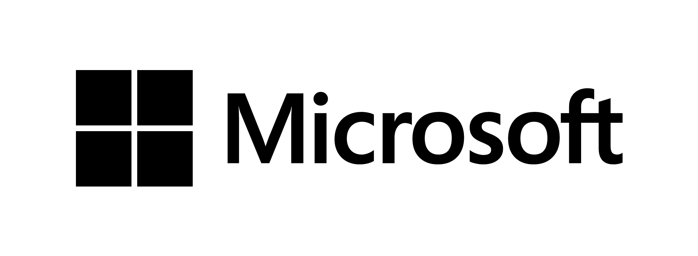

Introduction to App model architecture

Slide 2
Agenda
Introduction to app model
Logical Architecture for SP online service
pre and post convergence
Network model and security impact
Building up the app model service
Provider hosted platform options in pre and post convergence
App governance considerations
ALM process changes

Slide 3
Introduction to app model

Slide 4
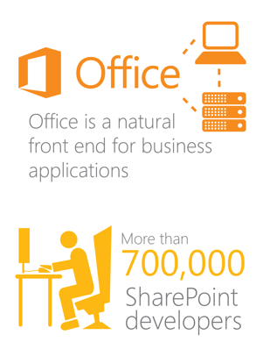
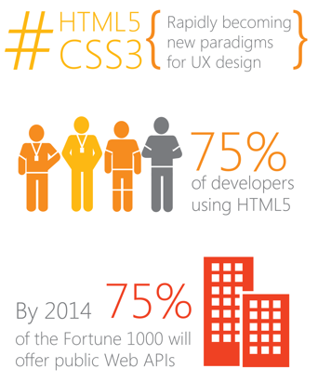
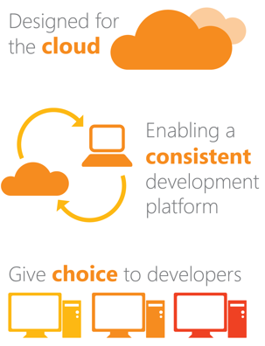
Our Vision: Modernizing the Platform
Today’s Market
Today’s Trends
Our Principles
Notes:
Title: Our Vision: Modernizing the Platform
Timing: 5 minutes
Today’s market:
Includes Office as the natural front-end for business applications
There are over 700,00 SharePoint Developers
Today’s Trends:
Rapidly becoming new paradigms for UX design
755 of developers using HTML5
By 2014 75% of the Fortune 1000 will offer public Web API’s
Our Principles
Designed for the cloud
Enabling a consistent development platform
Give choice to developers

Slide 5

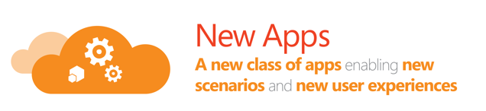
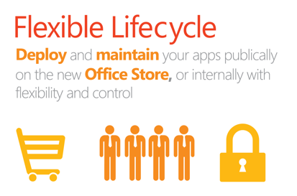
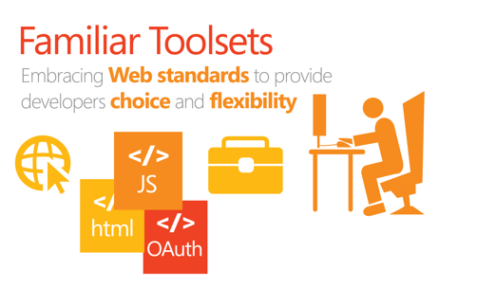
The Result: A new Cloud App Model
Notes:
Title: The Result: A new Cloud App Model (CAM)
Time: 3 minutes
Build a new class of apps that extend personalize the way we create and consume information right from within Office and SharePoint.

Slide 6



Build apps
Build
apps
Build
sites
Build for the cloud
A new development model for building apps provides a secure and scalable way to build SharePoint solutions.
SharePoint 2013 makes customizing sites easier for user, web designer and professional developer alike.
The cloud provides you with the freedom to choose how and where to host your apps.
Notes:
Title: None
Time: 2 minutes
Within the last decade the internet has evolved tremendously. From simple pages to robust social sites that support loosely coupled yet highly integrated 3rd party apps. From the beginning of SharePoint to today, SharePoint has also made significant changes from being a portal site to our newest release. SharePoint 2013.
For the developer and ultimately benefiting the user, SharePoint 2013 has made a significant investments to provide a new way to bring custom solutions to users with the new web standards-based cloud app model that are easily discoverable and yet will give IT and developers peace of mind knowing that they can scale, are safely isolated from SharePoint yet can leverage the full capabilities of SharePoint.
SharePoint 2013 also becomes web designer friendly. Now simple branding and theming can be handled by the SharePoint user, or richer branding experiences can be created by web designers and imported into SharePoint with a few simple clicks. Making the site design process easier for not only the web designer but the professional SharePoint developer as well.
The new cloud app model gives the developer the freedom of choice in how they implement apps for SharePoint. No longer are you tied to writing on top of the SharePoint platform, now you can write along-side it with the tools and web hosting platforms of your choice… Whether it is on premise or in the cloud… Whether the platform is IIS/ASP.NET, a part of the Windows Azure family of hosting options or a non-Microsoft web hosting platform. The final choice is up to you.

Slide 7



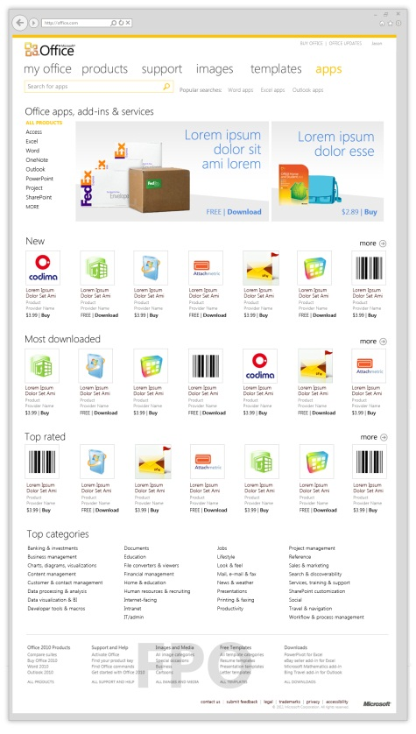


Apps and Market place license process
7
2
3
App Submission
Marketplace
SP Platform
APP
Storefront
APP
APP
Office AppHub
Office.com
4
6
1
5
Notes:
Title: Apps and Market place license process
Time: 2 minutes
Develop App with license checks
Submit App to Marketplace via Seller Dashboard
App available for purchase in SharePoint Store
User/Manager purchases App from SharePoint Store
If ON-Prem License information is copied to local App Service Application
Apps can bypass the SP store for example for in-house development
User/Manager assigns users (required for user limited licenses) and uses the apps which can hosted in SP or be provider hosted
User runs App
App validates license using access points in App Service Application
App enforces license

Slide 8










Evolution of SharePoint customizations
Full Trust Solutions
No real control
Sandbox
Partial control
App Model
Control, Trust, Manage
SP Code
SP Code
SP Code
Custom Code
Isolated App client side code
More custom code: aspx, dlls, web services, GAC
Sandboxed Custom Code
App code (client or server)
Host/language independent
Management and update easily doable per app
Emprases reusability
No server side sandbox, improved CSOM
Support is a nightmare
Upgrade is quite a challenge
Securing code to run in hosted environments is effectively impossible
Way too strict for developers
Hard to maintain and expand
Managed by your self

Slide 9

Customization Development and Deployment Options
Farm
Full trust solutions
Sandbox
Declarative elements
Partially trusted code service still included for limited server side support
SP Apps
New Apps model
Customizations to file system of servers
Deployed from corporate catalog or SharePoint store
Manage permission and licenses specifically
Classic model from 2007
Preferred option
Hosted in same process as SharePoint
Server side SharePoint API access
Hosted in isolated process
Limited server side SharePoint API access
Simple install and upgrade process
Code based sandbox solutions deprecated in SP2013
Notes:
Title: Customization Development and Deployment Options
Time: 2 minutes
SharePoint 2013 developers are now presented with three options when implementing projects in or with SharePoint 2013. Each of the app development options presents it’s own advantages and disadvantages:
Full-Trust Solutions:
Full trust solutions were introduced in SharePoint 2007 and allow developers to write code that can utilize the SharePoint server-side API. Custom code in these solutions is deployed to the hosting Web application’s BIN directory or global assembly cache (GAC). Code can be secured using .NET’s Code Access Security (CAS) but typically is run in full trust. These types of solutions are added to the farm in SharePoint by an IT Pro with console access and deployed by someone with farm administrator rights.
When errors occur in these types of solutions they can affect the hosting app pool and in the worst cases cause service outages.
These are the most unrestricted types of solutions that can be deployed via SharePoint. Full-trust solutions cannot be deployed in hosted SharePoint deployments; they are only available in on-premise installations. In full-trust solutions developers must manually code in any logic that should happen when the solutions are upgraded or uninstalled.
Sandbox Solutions:
Sandbox solutions, also known as user-code solutions, were introduced in SharePoint 2010. These types of solutions can be uploaded and deployed by site collection administrators. This flexibility comes with some trade offs in that only a subset of the server-side SharePoint API is available in custom solutions. In addition server-side code cannot make calls/requests to externally hosted Web services. However developers can use client-side based solutions (using JavaScript or Silverlight) to call external services and even make cross domain calls using techniques such as the HTTP post messages.
Sandbox solutions are the only types of solutions that can be deployed to hosted SharePoint installations. Similar to full-trust solutions, developers must manually code in any logic that should happen when sandbox solutions are upgraded or uninstalled.
SharePoint Apps:
SharePoint 2013 introduces a new development model, the “SharePoint app model”, that addresses limitations of the solution-based approach. The new app model can leverage new support for OAuth where apps can be granted permissions to do things within SharePoint sites and even be packaged and sold through a public or corporate marketplace. In addition to the OAuth support added in SharePoint 2013, Microsoft also improved the API surface and capabilities in the client-side object model (CSOM) and REST API’s for more client-side & remote server-side code solutions. In addition to the Marketplace support, Microsoft made considerable investments to make the install/upgrade/uninstall process of apps a very end user friendly experience addressing a common developer challenge in previous versions of SharePoint and the solution-based approach.
One limitation this approach is that server side code is explicitly prohibited in these types of customizations. Any server side code should be hosted outside of SharePoint in the cloud or elsewhere.

Slide 10
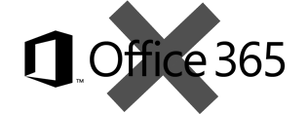
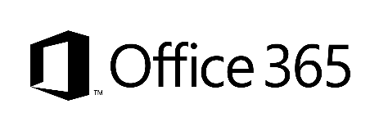
Redefining application models for SharePoint
Classic - Full trust solutions
ISV solutions
Client Side Solutions
Remote provisioning for elements
SP Apps
App catalog based solution
Custom service applications
Custom WCF services
Platform level customizations to on-premises
Server side controls as JavaScript on page layouts and master pages
Embracing un-ghosted model
SP App dimension with provider-hosted apps to provide new capabilities
Packaged reusable solutions built for specific functionality
SharePoint customizations, not customer-specific customizations
Customer-specific customizations
Not only for marketplace or store, but also as platform for customer-specific customizations

Slide 11
Impact of the customizations
Maintenance and operational costs, including availability challenges
Agility to deploy new functionalities and widgets
Long term roadmap impact
Notes:
Title: Impact of the Customizations
Time: 1 minute

Slide 12
Benefits
No custom code on the SharePoint server
Easier to upgrade to future versions of SharePoint
Works in hosted environments w/o limitations
Reduces the ramp-up time for those building apps
Don’t need to know/be as familiar with SharePoint “-isms”
Leverage hosting platform features in new apps
Enables taking SharePoint apps to different levels – further than what can be done with farm / sandbox solutions
Functionalities can be relocated to and from the cloud to any SharePoint deployment

Slide 13

SP App Hosting Options
SharePoint
Oauth + REST or client object models
Existing sites and services
The app and all resources are hosted by the provider in any environment suitable for the app.
App web (optional)
Removed
Auto- hosted
Oauth + REST or client object models
Existing sites and services
The app is hosted in the cloud. Windows Azure and SQL Server Azure components are provisioned automatically when an app is installed. (Available for SharePoint Online only)
App web (optional)
Windows Azure & SQL Azure
SharePoint
hosted
Existing sites and services
The app and all resources are hosted in your organization’s SharePoint farm. Relies on client side technologies. Your IT organization supports the app.
App web
Notes:
Apps for SharePoint can be self-hosted by a developer, auto-provisioned by Azure, hosted by SharePoint, or a combination of these. All can leverage SharePoint components. Custom code can only be run in developer self-hosted or Azure auto-provisioned hosting options.
The app is hosted in the cloud. Windows Azure and SQL Server Azure components are provisioned automatically when an app is installed. (Available for SharePoint Online Service only.)

Slide 14
App Shapes for SharePoint
Full page
Implement complete app experiences to satisfy business scenarios
Parts
Create app parts that can interact with the SharePoint experience
UI Command extensions
Add new commands to the ribbon and item menus

Slide 15
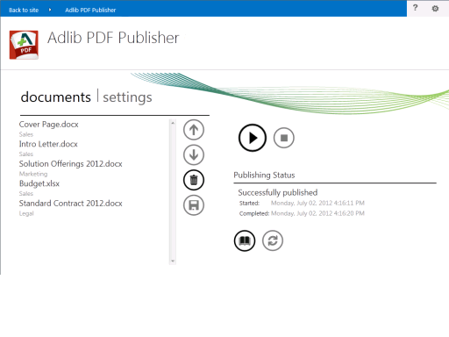
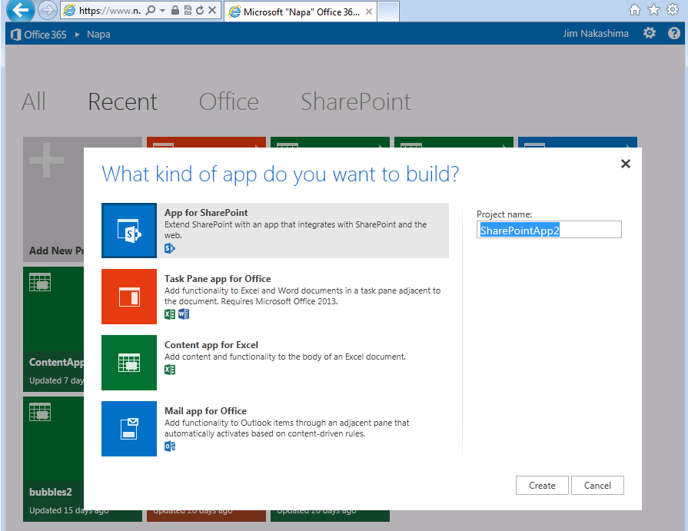

Slide 16
App Shapes for SharePoint
Full page
Implement complete app experiences to satisfy business scenarios
Parts
Create app parts that can interact with the SharePoint experience
UI Command extensions
Add new commands to the ribbon and item menus

Slide 17
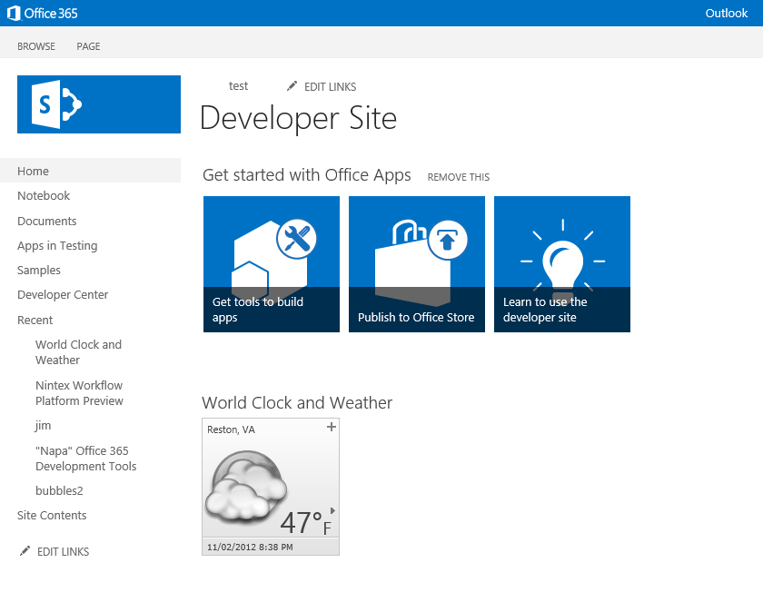
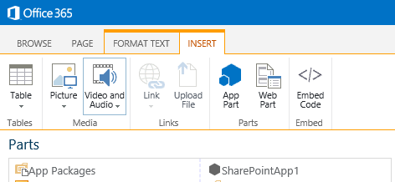

Slide 18
App Shapes for SharePoint
Full page
Implement complete app experiences to satisfy business scenarios
Parts
Create app parts that can interact with the SharePoint experience
UI Command extensions
Add new commands to the ribbon and item menus

Slide 19
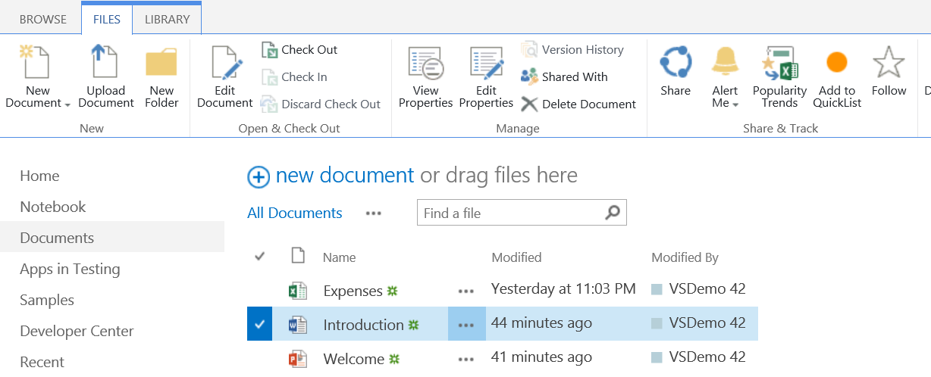
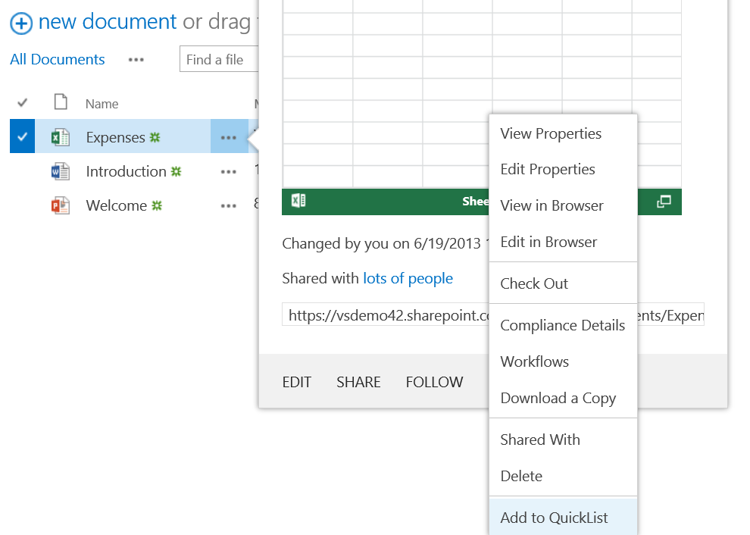
UI Command – Ribbon/Menu Action

Slide 20
App authentication to SharePoint
Two options in SharePoint
ACS based – so called two legged oAuth model where trust is established using third party provider, which in this case is the ACS
Server to server or high trust – trust is established directly between the app and the SharePoint farm using certificate
App authentication does not influence customization implementation details
ACS model is required with Office365 and does require provider hosted environment to have Internet connectivity
S2S model does not require Internet connectivity

Slide 21
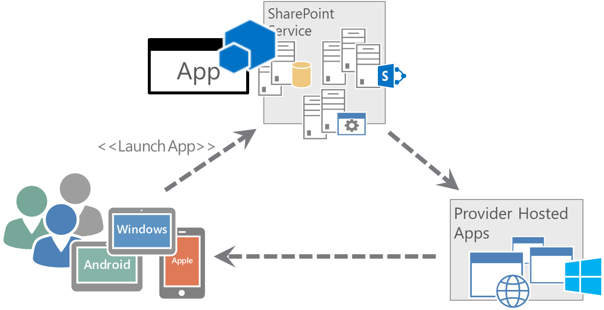
Windows Azure Access Control Service Overview
The Windows Azure Access Control Service (hereafter referred to as ‘ACS’) is a cloud based service hosted by Microsoft and part of the Azure Services platform. It is able to broker trust enabling SharePoint 2013 to authorise requests from remote applications, ensuring secure access to SharePoint’s resources. It is a free service.
ACS supports the OAuth 2.0 security protocol, which is the version used by SharePoint platform. This protocol uses ‘tokens’ to provide access to resources. We refer to a service like ACS as a Security Token Issuer (STS).
ACS is currently the only STS supported by SharePoint online (both dedicated and multi-tenant platforms).
ACS is required to support Provider Hosted Apps in O365 environment. A Provider Hosted App is launched from SharePoint and may depend on SharePoint’s services and content, but it’s hosted by remote servers. An ‘App’ component is deployed to SharePoint but there is no need to deploy components directly to SharePoint that might introduce performance or stability issues.
ACS can be used in on-premises as well
Provider Hosted App

Slide 22
ACS flow with provider hosted app Case Office 365 Dedicated
Registration of app id and secret
Publishing to SharePoint farm
End users are accessing SharePoint
Some functionalities are coming from provider hosted application side
Initial request from the provider hosted app is containing app ID and secret for getting access token to SharePoint
Provided client ID and secret is checked from the ACS and access token is provided, if the information is correct.
ACS model is used with the Office365 Dedicated and can be used with on-premises as well. It requires Internet connectivity from provider hosted servers.

Slide 23
CSOM or REST?
CSOM and REST are both valid techniques for the provider hosted apps to operate against SharePoint
Both techniques are commonly used, since they have different advantages
REST – Can be used also from non .NET platforms
CSOM – Exposes additional critical remote operations than REST
CSOM operation are executed in batches, which reduces the network traffic
REST operations are executed by default without any caching or batching
Provider hosted app developer can decide which technique would be used for specific operation
Some operations will still require old web service calls as well, like user profile update
CSOM and REST have different remote capabilities, so both have to be currently used. This is planned to be changed in future, but currently numerous APIs are only exposed from the CSOM

Slide 24
Required developer skills for app model
SharePoint client side object model and REST interface understanding
Standard client side techniques for JavaScript based implementations, including jQuery and other common libraries for standard web development
Standard asp.net web development experience
SharePoint functionality details to promote out of the box capability reuse
De-customize and use oob, rather than add provide each widget as custom solution
Business case analyses for each of the suggested capability. Cost vs. value analyses

Slide 25
Evergreen and release cycle – old model
SP2013
O16
O17
O18
Upgrade
Upgrade
Upgrade
Upgrade
Specific upgrade project each time new version is introduced
Customizations have to be upgraded to get access on new capabilities in product
Will cause additional costs during each release cycle of customizations
Customization updates cause downtime each time something is changed
Complex ALM processes for ensuring quality of the code
Tightly coupled SharePoint customizations
Notes:
Title: Evergreen and release cycle – old model
Time: 2 minutes

Slide 26
Evergreen and release cycle – new model
SP2013
O16
O17
O18
Customizations will utilize services from SharePoint and other services, but won’t usually change out of the box services.
Development
Loosly coupled SharePoint customizations
You choose when and how applications are updated
Backwards compatibility for API level to move customizations cross versions
Customizations don’t block new capabilities from SharePoint
Customizations extend, not change SharePoint
Customizations can be updated with minimal impact on SharePoint
Notes:
Title: Evergreen and release cycle – new model
Time: 2 minutes

Slide 27
Post-convergence architecture

Slide 28
SharePoint Online Architecture
Note. Descriptions in slide notes
Notes:
Roaming internal users or External users are accessing the service directly cross the Internet. This will enable also access to the service using any device which has Internet connectivity, like IPad or mobile phones. Devices can access service using either browser or native app functionalities. Access cookie can be stored to he device for single sign on experience. Actual authentication can happen based on user policies and can also have for example two phased authentication using SMS, if needed.
All accessing devices and users are authenticated using ADFS, which is working as a STS. This is being currently tested with ADFS POC. External users are authenticated against the service exposed by ADFS.
Support for external access with claims have to be still clarified with the DonMT crew. This was raised to discussion with PG, but definite answer is not yet available
Internal users accessing through ADFS are authenticated against Contoso corporate AD
After access is authenticated, requests are routed to Office365 services
Internal access by default is happening cross the Internet as well. Single sign on can be achieved with ADFS and sync’ing user identities to Office365 side (step 9).
Roaming internal users and External users can access internal services using reverse proxy
Internal services are published using reverse proxy techniques, similarly as the on-premises SharePoint farms
General internal service or LOB system
Identities are replicated to the DonMT environment using DirSync. This will ensure SSO cross environments since identities are the same cross the sides
Roaming internal users, external users or Internal users can access apps in the Windows Azure. Apps can be secured using SP oAuth model. More advance authentication models can be also setup users are accessing the provider hosted apps also outside of the SharePoint content. This could be two phased authentication patterns with ADFS support and SMS.
Actual apps uses oAuth to access SharePoint services
Optional MPLS link for private access from on-premises to DonMT environment. Would require complex network setup and value compare to the secured traffic over internet is not clear. Could be beneficial for the people accessing DonMT service from corporate network.
Possible connectivity from the on-premises toAzure. Point to Point VPN for connecting services directly to croporate network. Express Route for dedicated bypass of Internet traffic. Service Bus technique can b used to securely accessing LOB or internal services from the Windows Azure for exposing some internal functionalities directly in the cloud.

Slide 29
Provider hosted app environments options
On-premises
Windows Azure PAAS platform for the target architecture
On-premises standard infrastructure as the short-term architecture
Works with Office 365 Dedicated, but not with MT
Requires MPLs link in Office 365 Dedicated setup
Microsoft Azure
DCS for both the target architecture and the short-term one

Slide 30
Provider hosted app hosting patterns
There are 3 basic patterns for setting up the provider hosting environments:
Shared: Apps are hosted as separate web sites on a shared IIS servers farm (on-premises) or Azure Web Sites
Dedicated: Each app is hosted on its own dedicated IIS servers farm (on-premises) or own Azure Web Roles
Per-LOB: Each LoB has its own dedicated IIS server farm (or Azure Web Roles) and all apps belonging to the LoB are hosted on that farm (Web Roles)
The next slides describe each option in more detail

Slide 31
Shared Provider hosted environment pattern
Each app is hosted in its own asp.net web site in an shared IIS farm or as a separate web site on Azure Web Sites
Load balanced for high availability perspective
Note. Descriptions in slide notes
Notes:
This is the generic model which in Contoso’s case would be implemented using Shared web hosting for simple apps (“Web Hosting - Shared Web - Add”) from the IT catalog
Users who are accessing the provider hosted apps. ADFS used to identify the user
Load balancer for handling the incoming requested
Actual provider hosted servers which are load balanced
Provider hosted apps which are hosted in own IIS applications. Multiple apps in single load balanced setup (shared platform)
Provider hosted apps might have requirements to access other services like AD, ADFS, Database or any other resources. This is completely dependent on the app implementation details

Slide 32
Dedicated Provider hosted environment pattern
Each app is hosted in its own ASP.Net IIS application or its own Azure Web Roles
Load balanced for high availability perspective
Note. Descriptions in slide notes
Notes:
This is the generic model which in Contoso’s case would be implemented using Shared web hosting for simple apps (“Web Hosting - Shared Web - Add”) from the IT catalog
Users who are accessing the provider hosted apps. ADFS used to identify the user
Load balancer for handling the incoming requested
Actual provider hosted servers which are load balanced
Provider hosted apps which are hosted in own IIS applications. Multiple apps in single load balanced setup (shared platform)
Provider hosted apps might have requirements to access other services like AD, ADFS, Database or any other resources. This is completely dependent on the app implementation details

Slide 33
Per-LOB provider hosted environment pattern
The apps for one LOB are hosted according to the shared pattern
Every LOB has its own dedicated environment
A mix of the 3 patterns is also possible
Note. Descriptions in slide notes
Notes:
This is the generic model which in Contoso’s case would be implemented as a DCS - Server - Wintel - Add from IT catalog, but server would be used to host multiple LOB applications for specific organization.
Users who are accessing the provider hosted apps. ADFS used to identify the user.
Load balancer for handling the incoming requested
Actual provider hosted servers which are load balanced. Multiple server pairs managed and operated by the different organizations.
Provider hosted apps which are hosted as own IIS applications. Multiple apps in single load balanced setup (combined dedicated per LOB as shared platform for LOB specific apps)
Provider hosted apps might have requirements to access other services like AD, ADFS, Database or any other resources. This is completely dependent on the app implementation details

Slide 34
General rules for provider hosted in on-prem environment
Load balanced Windows Server hosting ASP.net application in IIS
Low trust (ACS) oAuth model requires Internet connectivity for server side for Office365 Dedicated app environment
Typical web server hardware requirements
Minimum: 8 GB, 4 cores
Recommended: 16 GB, 8 cores as a typical setup
Optional SQL Server instance for possible databases used in provider hosted apps
Each provider hosted app has specific own domain which is routed in dns
Domain depends on policies, but quite often look something like spapp-appname.group.Contoso.com
Actual layout is dependent on usage model, but we should be fine with load balanced 3 servers per location
Each app is hosted from these same servers

Slide 35
Corporate App Store
Each SharePoint application has it’s own corporate app store
Globally released apps must be replicated cross SharePoint farms from centralized location using remote scripting. No OOB capability for this
Corporate Apps are usually categorized like follows (example from MSIT)
Global Apps – Replicated cross environments – “All farms”
Local / Organization apps – Only in current environment – “Per Satellite/Hub”
Special apps – Case by case process with limited visibility – “Contoso apps - By request only”
End users can either request and app or install them directly from the public story
Configuration option in the SharePoint to select the wanted model
Public store is not available from Hubs/satellites where there’s no Internet connectivity

Slide 36
Corporate app store in enterprise level
Each application has it’s own corporate app catalog in on-premises
This also applies to Office365 Dedicated
In Converged platform there is only one catalog for all of the site collections hosted in that environment
Corporate wide deployment of app requires app to be copied cross multiple farms and applications. This can be automated with scripting since there’s no native capability in the SharePoint for this.
Note. Descriptions in slide notes
Notes:
Public store can be enabled or disabled in farm level. When enabled, administrators can configure apps to be directly available for installation or that end users have to request them from the the admins. Public store requires internet connectivity from the SharePoint farm
Apps can be deployed cross multiple applications using scripting.
Apps can be deployed to be available in each catalog in web application and in farm level using PowerContoso and client side object model (CSOM)
There is one app catalog for each web application in the farm. This gives us opportunity to provider only web application level publishing of the apps or app to be just available for specific organization
Scripting of the deployment cross multiple farms can be also done. There’s no native capability to move apps between web applications or multiple SharePoint farm.

Slide 37
Development, testing and acceptance (DTA)
Notes:
Development environments are managed and owned by developers. These are not provided by the Contoso, they are managed and owned by the developers/partners who work together with Contoso resource on the development.
Bring your own dev set – “BYODev”
Each dev environment consist from computer and isolated dev tenant in Office365.
No specific server hardware is required for development, since server side access is not needed
Source code is stored to Visual Studio Online, which is SaaS based service provided by Microsoft for TFS functionality
Authentication to VS Online is based on the Microsoft identity accounts (old Live ID)
Contoso can outsource the permission management to chosen partner, if needed or own the management of access by them self
VS Online can be also used for work item and bug tracking, including release planning
Isolated test environment in the Office365 with Microsoft Azure is used for testing of the capabilities. This is isolated from the production usage.
Testers have specific accounts to access this environment and no ADFS or ADFS connectivity is required, unless wanted. DirSync can however be performed against only one tenant, so native SSO is not currently available.
For on-premises functionalities, automated builds are compiled to Contoso’s corporate network, to isolated test environment for on-premises functionality
This is on-premises test / acceptance testing environment which consists of a small SP2013 farm and specific provider hosted environment
Test environment is associated using ACS to the test tenant for ACS based oAuth testing
Environment can be still used also for S2S testing, since used model is based on the app configuration
Contoso or selected partner can manage the permissions and other operational aspects of the VS online
Internal users are accessing the test tenant on office365 MT side using specific accounts, no SSO is needed for this tenant due limited access
Internal users can access the on-premises setup of the SharePoint for testing specific app capabilities

Slide 38
Roles and responsibilities in TDA
Development environment
Team foundation server (code and tasks)
Cloud Test & Acceptance environments
On-prem test and acceptance
Development environments are brought by developers – bring your own dev box
Development happens from own lap top directly against developer tenant in Office365 owned by developer
No VMs for the developers, since app development does not require servers
Initially hosted in Contoso on-premises, but should be relocated to VS online for easier access
VS online can be then easily used as centralized source code and life cycle management system for the SharePoint teams in Contoso
Separate tenant for testing code by acceptance testing
Separate test environment for on-prem testing
SSO can be provided with ADFS, if needed (POC ongoing), but technical no required for testing
Needed only if on-premises SharePoint deployments as well
Hosted in on-premises or Azure by customer
Apps cna be hosted also from Windows Azure PAAS platform if they have access to the SharePoint environment

Slide 39
On-premises – SP hosted app domain
If SP hosted apps are planned to be used in the on-premises farm, specific wild card app domain has to be registered for each of the SharePoint farms
App domain for SP hosted apps is recommend be dedicated new domain for providing domain level isolation

Slide 40
App governance considerations Things to discuss in detail for governance…
1
2
Validation Process
Developer
Development support
Test environments
Pre-Verification processes
ALM process
Testing process
Validation process
Who, what, when
Approvals
App Admin
5
3
4
Monitoring
Version management
Issue resolution plan
Provider hosts
High trust setup / ACS
DR implications
Classification
End Users
New app notifications
Feedback channels
End user support & training
Notes:
Some of these have to be discussed in detail, but some can be addressed more detailed as a recommendation from Microsoft side based on the Contoso’s environment. Some are already addressed in this deck.
Developer follows updated developer guidance during development. When app has been tested and verified, it will be submitted for internal review
App Admin performs standardized validation process to the app. Validation check list can be difference based on the planned release target of the app and where it will be hosted.
App is installed to the farm by the app admin and tested. Provider hosted platform is monitored and there’s clear issue resolution plan in case of any surprises.
End users will get notifications on the new apps, so that they know that they are available. There is also standardized feedback model to provide guidance and to receive feedback on the app
Feedback and input channel back to the app admin and to the developer

Slide 41
Office 365 Dedicated architecture

Slide 42
Pre-convergence architecture
Note. Descriptions in slide notes
Notes:
External users access the services using Contoso’s reverse proxy. Devices can access the services only using browser, no native app support
Roaming internal users are accessing the services using similar access than external users, unless they connect to corporate network using VPN
Provider hosted apps are also published to externally accessing users with the reverse proxy
Provider hosted apps are accessing the SharePoint online service using oAuth with the ACS model
Domain depends on policies, but quite often look something like spapp-appname.group.Contoso.com
Users outside of the corporate network can access the SharePoint Online Sites using reverse proxy
Existing MPLS link is used for accessing the MSO servers
Existing model with identity replication to MSO datacenter is used for authentication

Slide 43
DTA - Pre-convergence with dev servers
Note. Descriptions in slide notes
Notes:
Developer set consists from dedicated single server SharePoint 2013 installations which are hosted in virtual environment
Similar to what is currently used in Contoso
One tenant is created to be used as the ACS for development environments for oAuth mechanism, so that development matches the Dedicated model
Each development environment is associated to this tenant for ACS usage using same certificate
Tenant could be one developer tenant with single account, since actual tenant is used only for the ACS purpose
Environments are linked to the TFS in on-premises to store the source code
Test provider hosted environment is needed for integration testing
Test SP environment matching Dedicated environment design is used for integration testing and initial user testing
Actual acceptance testing can be done in PPE environment
Provider hosted environment and test SharePoint environment is associated to the Tenant for ACS based oAuth

Slide 44
Pre-convergence architecture limitations
SharePoint hosted apps
Not available for SAML users, so to be avoided and provider hosted apps should be used
ADFS (or ADFS 3.0) is needed for this
Generally provider hosted apps are always recommended on top of SP hosted apps
App store
Public SharePoint store would not be available due SAML limitation
Corporate deployed provider hosted apps available also for external users
Requires them to be published from reverse proxy

Slide 45
Phases for the convergence / cloud transition
Upgrade to 2013
Upgrade to 2013 native mode
Removal of FTC dependency
This is waiting for PG fix. Fix is committed, work is on the way
Setup Azure AD sync
Setup infrastructure
ADFS has to be present as well
Gradual move
Switch OneDrive for Business sites to new platform
Start creating new team sites to new platform

Slide 46
Setting Azure AD sync infrastructure Office 365 Dedicated guidance
Your SDM will have to create CR for getting converged tenant for you
DO NOT just create a Office365 trial tenant
For getting forward with DirSync planning, follow these steps
If you will be syncing a single forest to the converged Office 365 D platform, DirSync is the applicable tool. The DirSync zip package can be downloaded here. Multi-forest requires FIM based solution.
Prepare for directory synchronization - As an administrator, you need to do some preparation before you synchronize your local Active Directory to WAAD. This article contains a review object limits, requirements for the directory synchronization computer, requirements for the domain controllers, performance considerations, hardware recommendations and UPN Requirements.
Clean Up Active Directory - Your Active Directory environment must be properly configured in order to work with single sign-on. In particular, the userPrincipalName (UPN) attribute, also known as a user logon name, must be set up for each user in a specific way.
Activate directory synchronization - You must activate directory synchronization before you install the Directory Sync tool.
Set up your directory sync computer – there are 2 choices:
Install or upgrade the Directory Sync tool
Install the Directory Sync tool on SQL Server

Slide 47
Gradual move / migration details
Move sites gradually
Start with OneDrive
New team sites to new platform when wanted
New URLs to sites
With dedicated the URLs can stay in format of intranet.contoso.com
Old platform can exists simultaneously
Migrate gradually old sites
Notice that URLs would change

Slide 48
“Gradual move” architecture
Notes:
Identities are sync’d from on-prem environment to the cloud for sigle sign on experience
DirSync is required for the directory sync to happen automatically
Users are authenticated when they access Office365 Converged environment against customer ADFS (STS). Actual authentication of the access (browser, applications and native apps in devices) can have two phased authentication and this is controlled on the ADFS side.
Authorization is performed towards local AD
Internal users can access the Converged environment using single sign on capabilities. Users can select user ID and password to be saved to devices for automating the experience after initial authentication, if wanted.

Slide 49
Gradual move / migration challenges
URL model changes
URLs will remain the same
SP hosted app URL mapping can cause some issues
Social
Social news feed experience is isolated between the environments
Yammer can provide more cohesive social experience, but would require additional change management
Team site feeds can have some issues
User profile
Completely isolated between the environments
Custom user profile properties will have to be sync'd to cloud using a custom solution. Community IP exists.
Search
Isolated between the environments
People search results are dependent on the user profile properties
Configurations will have to be synchronized on both sides
End uses could move between environments using search center tabs
Terms
Will need to be sync’d between the environments using custom tool
Community IP does exist.

Slide 50
Building up the app model service

Slide 52
Case by case topics for the convergence changes

Slide 54
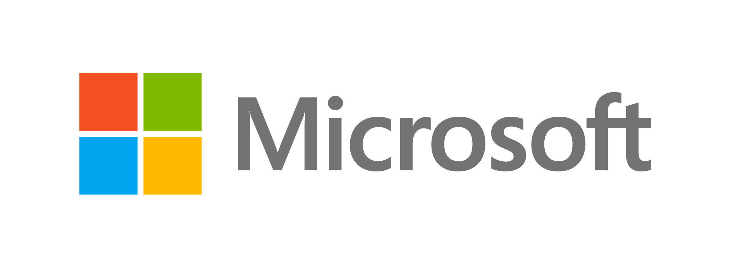

© 2014 Microsoft Corporation. All rights reserved. Microsoft, Windows, and other product names are or may be registered trademarks and/or trademarks in the U.S. and/or other countries.
The information herein is for informational purposes only and represents the current view of Microsoft Corporation as of the date of this presentation. Because Microsoft must respond to changing market conditions, it should not be interpreted to be a commitment on the part of Microsoft, and Microsoft cannot guarantee the accuracy of any information provided after the date of this presentation. MICROSOFT MAKES NO WARRANTIES, EXPRESS, IMPLIED OR STATUTORY, AS TO THE INFORMATION IN THIS PRESENTATION.

